Slide 1
RACO AV Wall Box and Large Data Box Presentation
June 5, 2020

Slide 2


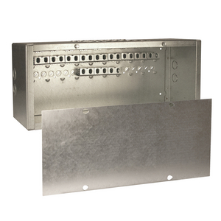
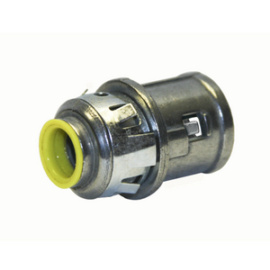
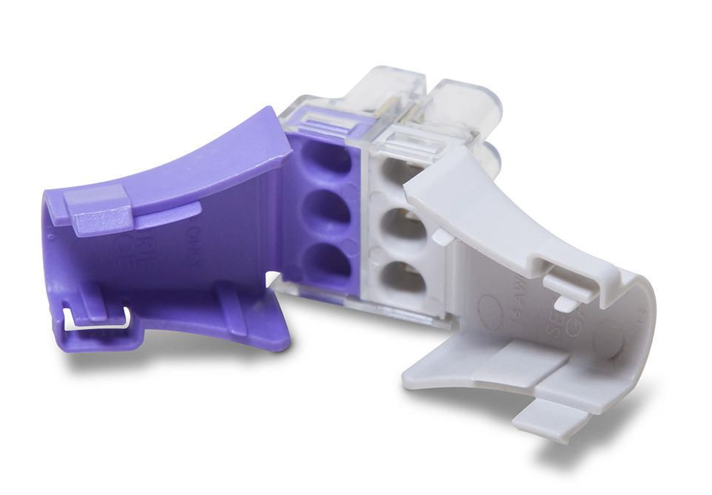

Coming Soon!
  Product Launches
    Plenum Line in June
  Webinar Series
    6-12-20: Block-Loc Boxes in Masonry Applications
    6-19-20: Certification Training Presented by Dan Gibson
    6-26-20: Plenum Box
    7-10-20: NPD Training
    July / August: Voice of Customer Series
  Product Promotion
    38RAC / 40RAC
    Dugout Launched in May
    MCPCS Connector
  Follow us on Social Media
    Hubbell Commercial Construction

Slide 3
RACO Gangable AV Wall Boxes
985, 986, 989

Slide 4
Features & Benefits – 985, 986, 989
Gangable design allows for installation flexibility
Accepts industry standard wall plates for consistent appearance
Knockouts from ½” up to 2”
4” depth accommodates large cables and any device
Raised ground provision in each gang
Adjustable stud mounting brackets built-in to accommodate different stud and sheetrock thickness

Slide 5
Application
RACO’s Gangable AV Wall Boxes provide an ideal solution for in-wall applications requiring data, AV, and power
Perfect for Cat6 and cat 6A fiber optic cables
Designed to install independently or gang together for multiple devices

Slide 6
Packaging
985
986
989
Carton Qty – 10
Pallet Qty – 560
UPCA – 050169009857
Carton Qty – 6
Pallet Qty – 336
UPCA – 050169009864
Carton Qty – 25
Pallet Qty – 8400
UPCA – 050169909898

Slide 7
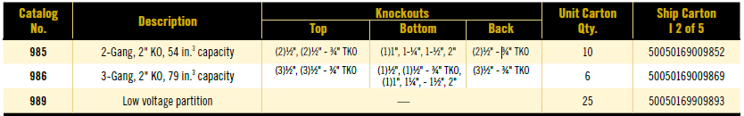
Data Table

Slide 8
RACO Large Capacity Outlet Boxes and Accessories
260, 263, 792,793,794, 981

Slide 9
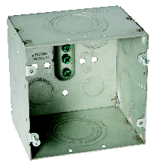
Features & Benefits - 260
cULus Listed
1” to 2” Concentric Knockouts For Multiple Applications
3-1/4” Deep Box Provides Room for Large Cable Bends and Eliminates Crowding
1” – 1-1/4” TKO
Uses Standard 4-11/16” Sq. Covers
Includes 3 Ground Screws
¾” – 1” TKO
Use RACO Catalog Number 981 Voltage Partition for System Separation
Mounts to Studs with Standard Brackets
Standard RACO 4-11/16” Square Construction
Use Cubic Inch Capacity (2.2 times that of a deep 1900 box). Great for Cat 6A, Fiber, and Pre-terminated cables.

Slide 10
Product Specification - 260
  4-11/16” Square Box, 3-1/4” Deep Steel Box
  66.7 Cubic Inch Capacity
  Side Knockouts:
    Two Concentric Knockouts for Data Conduits – 1”, 1-1/4”, 1-1/2”, & 2”
    Two Multi-purpose TKO® Knockouts for 1”& 1-1/4” Conduit or MC Connectors
    Two Multi-purpose TKO® Knockouts for ¾” & 1” Conduit or MC Connectors
  Back Knockouts:
    Two Knockouts for ½” Conduit or MC Connectors
    Two Multipurpose TKO® Knockouts for ¾”& 1” Conduit or MC Connectors
  Accepts RACO Voltage Partition Cat. No. 981 for Combination Power and Data Applications
  Works With Most Box Positioning Brackets
  Accepts Standard 4-11/16” Mud Rings and Tile Covers
  cULus Listed
  ROHS Compliant

Slide 11
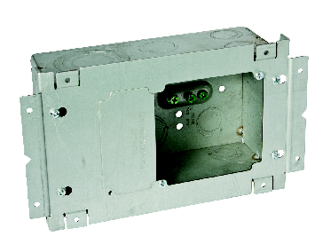
Features & Benefits – 263
cULus Listed
1” to 2” Concentric Knockouts For Multiple Applications
3-1/4” Deep Box Provides Room for Large Cable Bends, and Eliminates Crowding
Uses Standard 4” Sq. Covers
Mounting Cover Included
Includes 3 Ground Screws
Centering Notch on Cover for Quick and Accurate Mounting Height Locations
Use RACO Catalog Number 981 Voltage Partition for System Separation
Cover Mounts Directly to Studs or,
Between Studs Using Spanner Straps
113.3 Cubic Inch Capacity (3.7 times that of a deep 1900 box). Great for Cat 6A, Fiber, and Pre-terminated Cables
For 3-Gang Application: Remove Panel and Use RACO Cover, Catalog Number 792 (1/2”), 793 (3/4”), or 794 (1-1/4”)

Slide 12
Product Specifications - 263
  4-11/16” High x 7-3/4” Wide x 3-1/4” Deep Steel Box
  113.3 Cubic Inch Capacity
  Side Knockouts:
    Two Concentric Knockouts for Data Conduits – 1”, 1-1/4”, 1-1/2”, & 2”
    Two Multi-purpose TKO® Knockouts for 1”& 1-1/4” Conduit or MC Connectors
    Four Multi-purpose TKO® Knockouts for ¾”& 1” Conduit or MC Connectors
    Two Multi-purpose TKO® Knockouts for ½”& ¾” Conduit or MC Connectors
  Back Knockouts:
    Two Multi-purpose TKO® Knockouts for ½”& ¾” Conduit or MC Connectors
    Two Multi-purpose TKO® Knockouts for ¾”& 1” Conduit or MC Connectors
    Two Multi-purpose TKO® Knockouts for 1”& 1-1/4” Conduit or MC Connectors
  Accepts Standard 4” Mud Rings and Tile Covers
  Three Gang Mud Rings Available for Power, Data, and Voice applications
  Add Cat. No. 981 Voltage Partition for Power & Data applications
  Built-in Stud Mounting Bracket
  cULus Listed
  ROHS Compliant

Slide 13
Features & Benefits – 792, 793, 794
cULus Listed
RACO Catalog Number 792
3 Gang, 4” cover
Raised ½” Drawn
For ½” Drywall
Use with Catalog Number 263
RACO Catalog Number 793
3 Gang, 4” cover
Raised 3/4” Drawn
For 5/8” & 3/4” Drywall
Use with Catalog Number 263
RACO Catalog Number 794
3 Gang, 4” cover
Raised 1-1/4” Drawn
For Double 5/8” Drywall (1-1/4”)
Use with Catalog Number 263
Mounts with Screws Supplied with RACO Catalog Number 263
Notched for Use with RACO Catalog Number 981 Voltage Partition for System Separation
Tapped 6-32 Device Mounting Holes

Slide 14
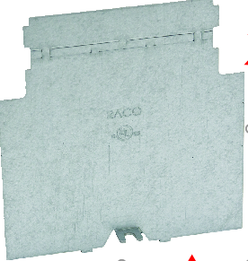
Features & Benefits – 981
cULus Listed
Break Off Here for Use with ½” Raised Covers
RACO Catalog Number 981 Voltage Partition
Used to Separate Power & Data Systems
Specifically for RACO Catalog Numbers 260 & 263 Boxes
For ½”, ¾” and 1-1/4” Raised Mudrings
Break Off Here for Use with 3/4” Raised Covers
Use as supplied with 1-1/4” Raised Covers
Mounting Tab, Secured with Ground Screw Provided in RACO Boxes Catalog Numbers 260 & 263

Slide 15
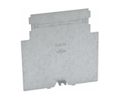
Features & Benefits – 981
  Separates System Voltages
  Single Piece Steel Construction
  Fastens in place to assure grounding
  Scored to Accommodate 1/2”, 3/4”, and 1-1/4” Deep Mud Rings
  cULus Listed
  ROHS Compliant

Slide 16
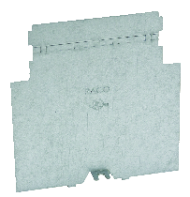
Packaging
260
263
981
Carton Qty – 10
Pallet Qty – 480
UPCA – 050169002605
Carton Qty – 6
Pallet Qty – 192
UPCA – 050169002636
Carton Qty – 25
Pallet Qty – 7,875
UPCA – 050169009819

Slide 17
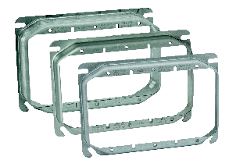
Packaging
792
793
794
Carton Qty – 10
Pallet Qty – 2,700
UPCA – 050169007921
Carton Qty – 10
Pallet Qty – 2,700
UPCA – 050169007938
Carton Qty – 5
Pallet Qty – 1,350
UPCA – 050169007945

Slide 18
Good Luck!

